Slide 1

Klinefelter's Syndrome
Educational Guidelines

Slide 2
Agenda
Introduction to KS/XXY
Common symptoms
The Team
How to support in the classroom
Where to find further information
Notes:
Current research indicates that a majority of students with KS/XXY will require some kind of school support plan (classroom accommodations or special education)
Appropriate intervention at the earliest stage will significantly reduce problems, boost achievement and ultimately lead to improved self-esteem.

Slide 3
Your child’s name here and some photos of them doing the things they love and showing who they are as a person
Notes:
e.g. Max is:
Kind
Generous
Sweet
Loves to cook and bake
Loves animals
Loves being outdoors – a good climber!
Enjoys dancing
Always wants to be with people
KS/XXY is just a part of who my child is, it does not define them. However, it can present some challenges throughout their lifetime, especially during their school years.

Slide 4
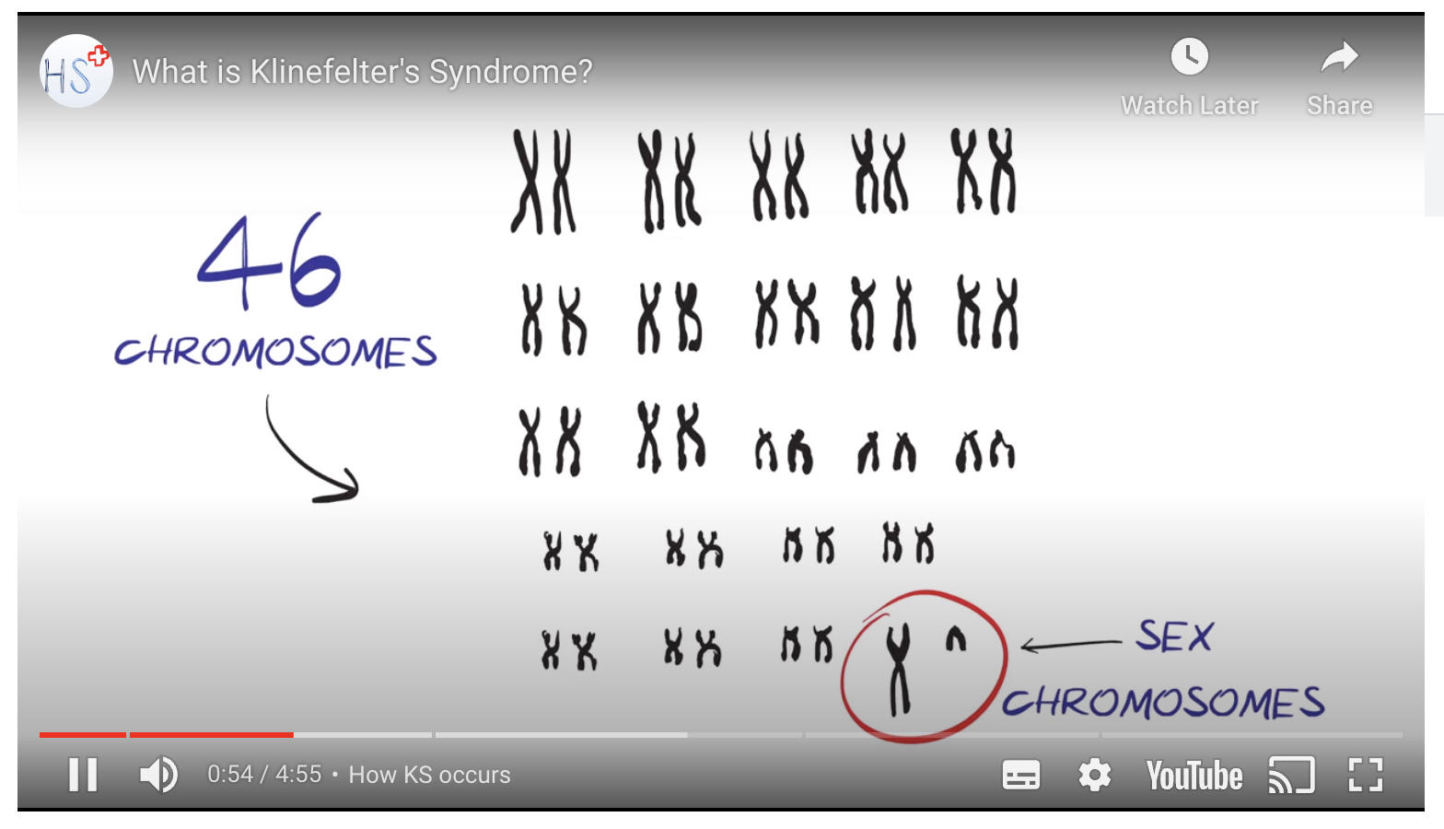
Introduction to KS/XXY
HealthSketch video - https://youtu.be/71ZyO437w4c
Notes:
Helpful for high-level overview of KS/XXY, but does not focus on symptoms in great detail, especially childhood and educational difficulties. This presentation will provide you with information on how KS/XXY can/does affect my child during/in the classroom and the different strategies and approaches that have been known to help support them.

Slide 5
Common symptoms
Physical symptoms:
    Tall stature with disproportionately long arms and legs
    Clinodactyly (curved pinkies)
    Lack of coordination (dyspraxia)
    Unexplained tiredness or lethargy
    Gynecomastia (breast development, often between the ages of 10 and 16)
Other common symptoms:
    Passive, shy, low self-esteem
    Dislike of sports, particularly team games
Notes:
KS/XXY can present with very subtle physical symptoms in childhood. Most tend to be are cognitive and psychological.

Slide 6
Common symptoms cont.
Cognitive symptoms:
    Speech and language:
      Often significantly verbally behind peers
      Poor communicator
      Interprets words literally
      Difficulty in conversation
    Behavioral:
      Frustration and anger
      Misinterpretation of facial expressions and tone of voice
      Doesn't like getting into trouble
    Learning difficulties:
      Reading accuracy, comprehension, and spelling
      3 out of 4 children with KS/XXY have a language-based learning disability (such as dyslexia)
      Phonemic discrimination
      Maths problem solving and calculation
    Executive function:
      Deficits in the areas of inhibition, mental flexibility, and working memory
      difficulty initiating and planning tasks
      Difficulty remembering recent conversations
      Difficulty processing information – especially verbal
      Audio Processing Disorder (APD)
    ASD and/or ADHD:
      Poor communication and social skills - difficulty in expressing personal thoughts, opinions and needs
      Short attention span – easily distracted
      Sensory sensitivity
Notes:
A child with KS/XXY may exhibit some or all of the symptoms listed above. KS/XXY is very variable in terms of symptoms.
APD explained:
Problems interpreting sound, recognizing the sound or understanding speech
Effect can be worsened by the presence of other conditions, such as:
Dyslexia
Language processing difficulties
Poor attention and poor sort-term memory
ADHD
Difficulty understanding speech in noisy environment
Trouble concentrating and reading when background noise is present
Problems may lead to difficulty in understanding and remembering instructions, speaking clearly and development of reading skills
For more information visit Great Ormand Street Hospital APD webpage: https://www.gosh.nhs.uk/medical-information-0/auditory-processing-disorder/#:~:text=When%20someone%20has%20APD%2C%20sound,the%20sound%20or%20understanding%20speech.
ASD/ADHD: UK research suggests that individuals with KS/XXY are 6 times more likely to have a neurodevelopmental disorder in comparison to those without KS/XXY.

Slide 7

The Team
Parents
Teachers
SENCO
Family Worker
Counsellor
Psychologist
Endocrinologist
Notes:
Amend this to who your child currently has in their ‘team’

Slide 8

How to support in the classroom
Strategies and approaches:
  Auditory processing:
    Verbal commands to arrive in shorter & slower bites than normal, then giving them time to make sense of what they have heard.
    Instructions should be visible using pictorials (if possible) in a simple list for ticking off as each is completed.
    Instructions need frequent repetition throughout the task, where instructions involve a series of tasks these will get out of sequence
    APD – sitting near the front of the class, teacher to check child is listening and back up verbal instructions with written/pictorial ones
  Auditory memory:
    Visual input helps here
    Offer diagrammatic and pictorial expression and organization - a quick drawing can prevent a long and fruitless description
    Look to developing short-term memory skills and in particular auditory memory - word games in non-competitive contexts can develop vocabulary and the powers of word recall.
Memory devices – explore ways of helping him remember lists and facts
  Concentration:
    Background noise and movement when trying to pay attention is distracting - teacher may have little effect even working 1:1 if the classroom is busy with activity
  Environment:
    Still and relaxed where possible
    Routine
    Visuals, but not too many that they become distracting
    Time-out - concentration will prove extremely tiring, this could lead to lack of concentration and short temper
Notes:
Your child may benefit from some of the strategies and approaches suggested above.
Auditory memory: Forgets what is said, quickly. Often an astounding memory for visual data is totally eliminated if the task is converted into words. The card-game “Fish” where pairs of cards must be identified whilst facedown, is easily managed; yet “get your books out as soon as you enter the classroom” is lost before the door is opened.
Concentration: Cannot purely listen for more than a few seconds.
Even relatively short times of 1:1 followed by work in a peaceful, supportive and productive environment have shown to lead to a profound improvement in performance, and, more importantly, to raise self-esteem and a sense of capability and equality.
Environment:
Routine: encourage the establishment of clear routines with discipline at the changeovers. Watch out for the KS/XXY child establishing their own routines within your own – some of these can undermine progress – the children need to be encouraged to acknowledge the needs and requirements of others and that they are not always the centre of attention.

Slide 9

How to support in the classroom cont.
Communication and confidence building:
  Encourage the use of descriptive expression
  Be aware of your hand movements – may become distracting
  Peer-partners and classroom-mentors
  Develop a culture of acceptance and inclusion
  Build up their own skills gradually, enable them to develop the capabilities needed to become more self-reliant and build self confidence
Academic intervention, accommodations and modifications:
  Meet in a small group or individually
  Assistive technology
    Low tech (such as special pencil grips, a slant board for writing, a handheld magnifier, books on tape)
    High tech (such as speech-to-text or text-to-speech software or other communication devices)
  Slight changes in presentation, format, or response procedures that alter how they learn or demonstrate knowledge of the content
  Teach priorities

Slide 10



Further information
Klinefelter's Syndrome Association (KSA)
  Become a professional member
AXYS Genetic.org
KF-Xtra Clinic, UCLH
The Klinefelter Syndrome Clinic, Guys’ and St Thomas
Living with XXY

Slide 11
References
    Education and Beyond – KSA, https://www.ksa-uk.net/download/education-and-beyond/
    The Learning Needs of Children with KS – Information for Teachers and Parents – KSA, https://www.ksa-uk.net/download/learning-needs-of-ks-children-rev/
    Educational Guidelines, IEPs, and School Services for Children with X & Y Chromosome Variations – AXYS, https://genetic.org/wp-content/uploads/2020/12/AXYS-Consensus-Document-Educational-Guidelines-IEPs-School-Services-updated-12-14-20.pdf
    Auditory Processing Order – Great Ormand Street Hospital, https://www.gosh.nhs.uk/medical-information-0/auditory-processing-disorder/#:~:text=When%20someone%20has%20APD%2C%20sound,the%20sound%20or%20understanding%20speech.

